Slide 1
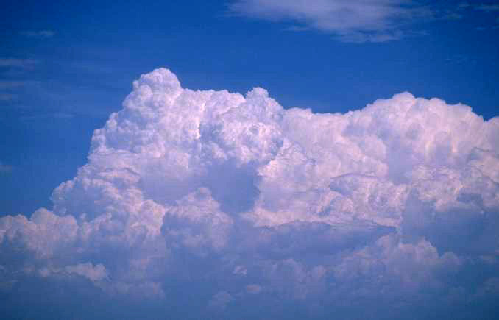
Our Cloud Of Witnesses
Hebrews 12:1-2
Notes:
With all the interest in the Olympics, I thought it was good to preach out of Hebrews 12:1-2

Slide 2
Hebrews 12:1, 2
“therefore” (v.1) connects the “cloud of witnesses” with those examples mentioned in previous chapter
Bible picture is of a race
  life’s race
  must run
  must have endurance (difficult)

Slide 3
Hebrews 12:1, 2
admonition to remove hindrances if we are to finish
  remove every weight
  remove sin
    easily ensnares
    (skillfully surrounding, Strong’s 2139)
keep eye focused on the Finisher
  Christ ran
  Christ endured
  Christ finished

Slide 4
DANIEL
1:4-8
The Race
Set Before Us
Must Enter
2 Tim. 2:5
Detour
A More
Popular Race
H+B+R+C+BAP.
Must Run
1 Cor. 9:24ff
Notes:
“Life’s Race” is not the most popular race! Most have enlisted the race to the gusto, pleasure, riches.
Most people do not like the race that you are running. It can often be a lonely race. Many religious friends differ with your race (celebrate birth of Christ; instrumental music in worship; etc). Others run for the bottle; dancing; drugs; etc.

Slide 5
Galatians 1:10
“For do I now persuade men, or God? Or do I seek to please men? For if I still please men, I would not be a bondservant of Christ”
Often the Popular Route that Pleases Many Is The Devil’s Detour!

Slide 6
DANIEL
1:4-8
NOAH
2 Peter 2:5
The Race
Set Before Us
Must Enter
2 Tim. 2:5
Detour
A More
Popular Race
H+B+R+C+BAP.
Must Run
1 Cor. 9:24ff
Notes:
“and did not spare the ancient world, but saved Noah, one of eight people, a preacher of righteousness, bringing in the flood on the world of the ungodly” (2 Pet. 2:5)

Slide 7
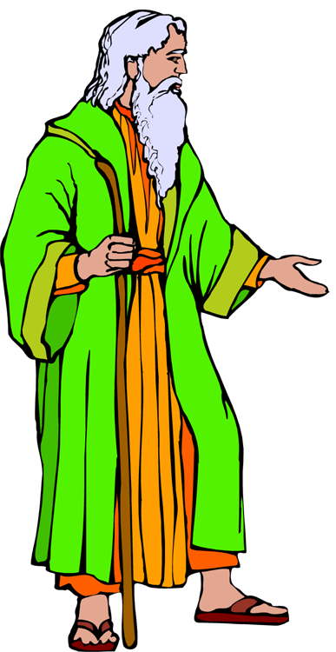
ABRAHAM:
What about moving to a place without knowing where you were going?
Hebrews 11:8, 9
The Race
Set Before Us
NOAH:
What if you must build an ark to be saved?
Hebrews 11:7
ABRAHAM:
Ever been asked to slay your own son?
Hebrews 11:17-19
Detour
Must Enter
2 Tim. 2:5
Easier Race
Detour
A More
Popular Race
H+B+R+C+BAP.
Must Run
1 Cor. 9:24ff
Notes:
We see other races where they boast on easy street. We begin to think that the commands of God are too burdensome. This may hit right in the beginning stages of life’s race; as in in running, it is the first few minutes that are the most difficult;
We may think that the “Mattress Springs Church of Christ” sounds better this Sunday. TV, sports, housework, etc. sound more appealing. A denomination that might sound more appealing when they don’t enforce church membership or teach the truth on discipline. A doctrine of “once saved, always saved” may make it a lot easier on you.

Slide 8
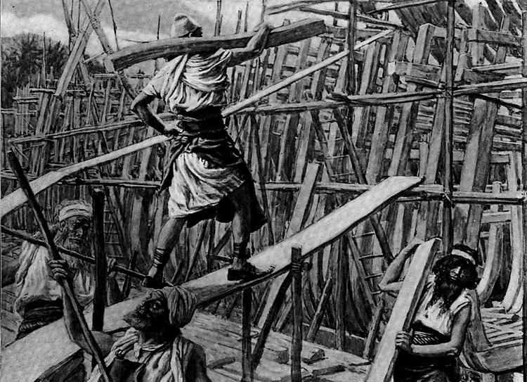
What If God Had Asked YOU!
to build an ark to be
saved?
to build an ark 1 ½ football fields long to be saved?
to build an ark 1 ½ football fields long, 75 feet wide and 4 ½ stories tall to be saved (Gen. 6:13-15)?
  would you have been saved?
  would your family have been saved?
  would humanity have been saved?

Slide 9

UZZIAH:
Advancement can have added temptations –lifted up to destruction
The Race
Set Before Us
EXIT FOR WORLDLY
ADVANCEMENT
Detour
Detour
Must Enter
2 Tim. 2:5
Easier Race
Detour
A More
Popular Race
H+B+R+C+BAP.
Must Run
1 Cor. 9:24ff
Notes:
Sometimes worldly offers can sidetrack you from the race of life. . .When the great dollar sign stares at you in the eye what will your response be if it takes you away from Christ? A great paying job, total financial security, excellent benefits. . .you just have to miss Wed. Bible study and a Sunday here and there. Promotions in authority or rank may cause some to have their ego bloated and through pride they cannot see beyond their nose.

Slide 10

UZZIAH
MADE A KING @ 16 yrs (2 Chron. 26:1)
STRONG DOMESTIC LEADER,
“Also he built towers in the desert. He dug many wells, for he had much livestock, both in the lowlands and in the plains; he also had farmers and vinedressers in the mountains and in Carmel, for he loved the soil” (v. 10)

Slide 11
UZZIAH
MILITARILY STRONG
  defeated Philistines, Arabians, Ammonites (paid tribute)
  “His fame spread as far as the entrance of Egypt, for he became exceedingly strong” (2 Chron. 26:8)
  2,600 chief officers
  307,500 in army, “. . .that made war with mighty power. . .” (2 Chron. 26:13)
  well supplied army (v. 14)
  state of the art guard towers (v. 15)

Slide 12
UZZIAH
WAS A SUCCESS FROM EVERY VIEWPOINT
  DOMESTICALLY
  MILITARILY
  SPIRITUALLY, “. . .he did what was right in the sight of the Lord. . .He sought God in the days of Zechariah. . .as long as he sought the Lord, God made him prosper. . .God helped him. . .” (2 Chron. 26:4, 5, 7)
  reigned 52 years (of OT kings, his was 2nd in length)

Slide 13
UZZIAH
But he was overcome by pride,
“But when he was strong his heart was lifted up, to his destruction. . .” (2 Chron. 26:16)
CONTRAST: “. . .out of weakness were made strong. . .” (Heb. 11:34)
Notes:
This is allowing a blessing to become a curse. We often desire the adversity to go away, but it just may be that it is the adversity in our lives that is keeping us strong and without pride.

Slide 14
MOSES:
Forsook honor, power, prestige, riches, etc.
(Heb. 11:24-27)
The Race
Set Before Us
Depart For Worldly
ADVANCEMENT
Detour
Detour
Must Enter
2 Tim. 2:5
Easier Race
Detour
A More
Popular Race
H+B+R+C+BAP.
Must Run
1 Cor. 9:24ff

Slide 15
MOSES
Acts 7:23, “But when he was set out, Pharaoh's daughter took him away and brought him up as her own son. And Moses was learned in all the wisdom of the Egyptians, and was mighty in words and deeds”
  But Moses “refused” it
  Self denial!
WHAT HAVE YOU DENIED?

Slide 16
Philippians 3:8
“Yet indeed I also count all things loss for the excellence of the knowledge of Christ Jesus my Lord, for whom I have suffered the loss of all things, and count them as rubbish, that I may gain Christ”

Slide 17
The Race
Set Before Us
Depart For Worldly
ADVANCEMENT
Family & Relationships
Detour
Detour
JOB:
Regularly made sacrifices for his sons (1:5)
Detour
Must Enter
2 Tim. 2:5
Easier Race
Detour
A More
Popular Race
H+B+R+C+BAP.
Must Run
1 Cor. 9:24ff
Notes:
A new off-ramp: Family & Friends
Your family members may have fallen away from the Lord? Will you follow them?
You may be the only one in your family who obeyed the gospel. They may scoff at you or simply discourage you with indifference. Will you then become indifferent? Will you become what they are if and when they want no part of Christ?

Slide 18
JOB
regularly offered burnt offerings for all children, but wondered if sons had sinned and cursed God
  later lost all of his children to a freak accident (working of Satan: 1:12, 19)
Wife acted like an atheist (2:9-10)
Friends didn’t encourage or speak truth (42:7)
Notes:
What is the adage, with friends like these, who needs enemies. Job had all this family adversity, but do not forget that he is in intense physical suffering all the while he is emotionally hurt and spiritually is desperate for answers.

Slide 19
DAVID:
Despised by older brother
(1 Sam. 17:28)
The Race
Set Before Us
Depart For Worldly
ADVANCEMENT
Family & Relationships
Detour
Detour
Detour
Must Enter
2 Tim. 2:5
Easier Race
Detour
A More
Popular Race
H+B+R+C+BAP.
Must Run
1 Cor. 9:24ff
Notes:
“Now Eliab his oldest brother heard when he spoke to the men; and Eliab’s anger was aroused against David, and he said, ‘Why did you come down here? And with whom have you left those few sheep in the wilderness? I know your pride and the insolence of your heart, for you have come down to see the battle.’” 1 Sam. 17:28

Slide 20
DAVID
subdued kingdoms,
worked righteousness,
obtained promises,
stopped the mouth of lions,
escaped the sword,
was made strong out of weakness,
was valiant in battle,
and turned to flight the armies of the aliens!
  Hebrews 11:32-34
Because David did not follow his brother’s example, he:

Slide 21
The Race
Set Before Us
Depart For Worldly
ADVANCEMENT
Family & Relationships
Detour
JESUS:
“and a man’s enemies will be those of his own household”
(Matt. 10:36)
Detour
Detour
Must Enter
2 Tim. 2:5
Easier Race
Detour
A More
Popular Race
H+B+R+C+BAP.
Must Run
1 Cor. 9:24ff
Notes:
A new off-ramp: Family & Friends
Your family members may have fallen away from the Lord? Will you follow them?
You may be the only one in your family who obeyed the gospel. They may scoff at you or simply discourage you with indifference. Will you then become indifferent?

Slide 22
Though Jesus’ brothers were unbelievers (Jn. 7:5):
He still had to do what was right
He still willingly submitted to His heavenly Father’s will

Slide 23
Too Much Cost
The Race
Set Before Us
Detour
Depart For Worldly
ADVANCEMENT
Family & Relationships
Detour
Detour
Detour
Must Enter
2 Tim. 2:5
Easier Race
Detour
A More
Popular Race
H+B+R+C+BAP.
Must Run
1 Cor. 9:24ff
Notes:
Some may enter the race but then after running for a while feel like the cost of keeping on is too much.
On life’s race course, some may find out that they are in an adulterous marriage and learn that they must get out of it if they are going to be acceptable to God. They may then choose to quit the race because of the personal cost. I’ve personally seen that. Some may feel that giving up a certain practice has too great of a cost to keep on going.

Slide 24
Is The Cost:
of getting out of an adulterous marriage too much to “finish the course”?
of stopping some sinful practice too much to “finish the course”?
of disciplining the disorderly too much to “finish the course”?

Slide 25
PAUL:
Suffered the loss of all things
Too Much Cost
The Race
Set Before Us
Detour
Depart For Worldly
ADVANCEMENT
Family & Relationships
Detour
Detour
Detour
Must Enter
2 Tim. 2:5
Easier Race
Detour
A More
Popular Race
H+B+R+C+BAP.
Must Run
1 Cor. 9:24ff
Notes:
Some may enter the race but then after running for a while feel like the cost of keeping on is too much.
On life’s race course, some may find out that they are in an adulterous marriage and learn that they must get out of it if they are going to be acceptable to God. They may then choose to quit the race because of the personal cost. Some may feel that giving up a certain practice has too great of a cost to keep on going.

Slide 26
PAUL
suffered loss of all things (Phil. 3:8)
1 Corinthians 4:9-13
2 Corinthians 11:23-29
Notes:
Note on 1 Corinthians 11:23-29 READ. When you are feeling down or blue or that you have too much on your plate, then please check back with this passage. Why is that people think the cost is too much. Paul stands in the cloud of witness against us if we fall short of the glory and sell out for any sin to lose Christ. But why would Paul go under so much pain and agony and yet remain faithful while others won’t even stop a sin or get out of a relationship?
The reason is in verse 28, 29. He actually has a concern for something more than himself. The churches verse 28. He sympathizes with the weak yet burns with indignation when one is made to stumble (literally scandalize).
“The idea is, that he felt in himself every reproach or suffering which affected any brother Christian” (Abbotts Illustrated New Testament). “When a brother stumbles, Paul is set on fire with grief” (Robertson’s NT Word Pictures). Paul felt the pain others went through while going through more than any other and even if one were to be seduced to fall away, Paul burned with Zeal to make him stand up straight before God.

Slide 27
PAUL
Would you be willing to offer an excuse of “cost” in judgment for not finishing the course while standing next to Paul?
one who had to fight beasts as a spectacle (2 Tim. 4:17; 1 Cor. 15:32)
one who had been whipped almost 200 times
one who had been beaten with rods three times
one who had been stoned once
shipwrecked
hungered
nakedness, cold, perils, etc.

Slide 28
PAUL:
Suffered the loss of all things
Too Much Cost
The Race
Set Before Us
Detour
Depart For Worldly
ADVANCEMENT
Family & Relationships
Detour
Detour
JESUS:
Endured The Cross
(Heb. 12:2)
Detour
Must Enter
2 Tim. 2:5
Easier Race
Detour
A More
Popular Race
H+B+R+C+BAP.
Must Run
1 Cor. 9:24ff

Slide 29
Jesus Endured The Cross
Not because it was a joy
because of the joy that was at the end of the cross
  be with God
  ultimately have us with Him in heaven

Slide 30
Our Lord’s Example
preaching was not “popular” with many
the road was not easy
  tempted in all points by the devil
  must live a sin-free life
  must die as a sacrifice
“worldly advancement” –offered the kingdoms of the world (Lk. 4:5, 6)
His own “friend” betrayed him; Peter denied Him; apostles forsook Him
His cost: leave heaven & die as a man condemned

Slide 31
Are You Tempted To Yield
To One of These Detours?
Too Much Cost
FOCUS ON THE FINISHER!
The Race
Set Before Us
Detour
Depart For Worldly
ADVANCEMENT
Family & Relationships
Detour
Detour
Detour
Must Enter
2 Tim. 2:5
Easier Race
Detour
A More
Popular Race
H+B+R+C+BAP.
Must Run
1 Cor. 9:24ff

Slide 32
Are You Tempted To Yield
To One of These Detours?
of life
FOCUS ON THE FINISHER!
The Race
Set Before Us
Must Enter
2 Tim. 2:5
H+B+R+C+BAP.
Must Run
1 Cor. 9:24ff

Slide 33
JAMES 1:12
“Blessed is the man who endures temptation; for when he has been approved, he will receive the crown of life which the Lord has promised to those who love Him”

Slide 34
Looking to the
Cloud of Witnesses
helps keep things in perspective
motivates
enhances endurance
  willing to suffer more when others are watching

